Slide 1
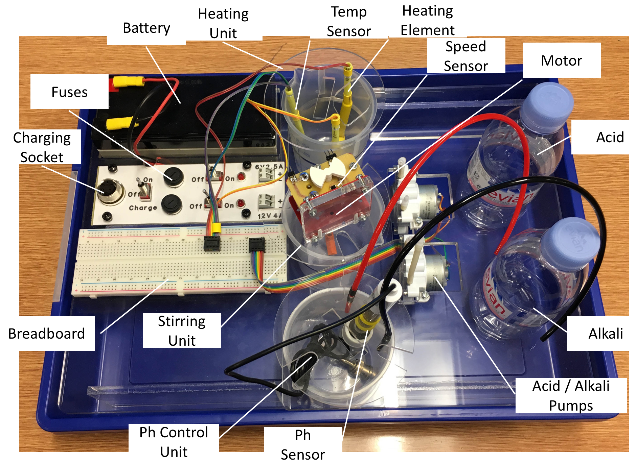
Bioreactor Systems Control

Slide 2
Design Process
Broke down task into subsystems and allocated members to each subsystem
Drawing of high level block diagram of overall task
Drawing of block diagrams for specific subsystems
Design of circuit board layouts and writing pseudocode
Implementation of circuits and code
Testing and modification of circuits and code to fit our technical specification.

Slide 3
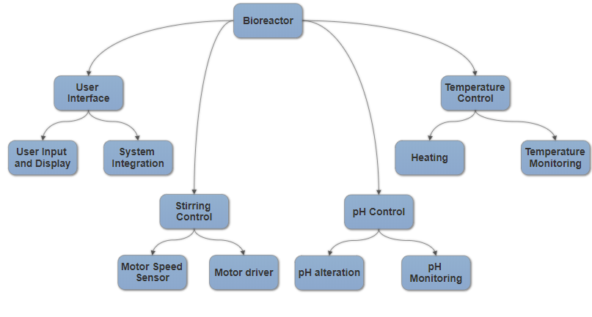
Overall System Block Diagram

Slide 4
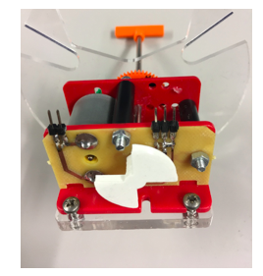
Stirring Control – motor speed sensor
Used a phototransistor and a piece attached to the motor
For every motor rotation the piece interrupts the phototransistor twice
Count number of interrupts in two seconds, divide by two, then multiply by 30 to calculate the current RPM.
Interrupt determined by a
change in voltage output by
the phototransistor
Stirring element
Motor
Plastic piece

Slide 5
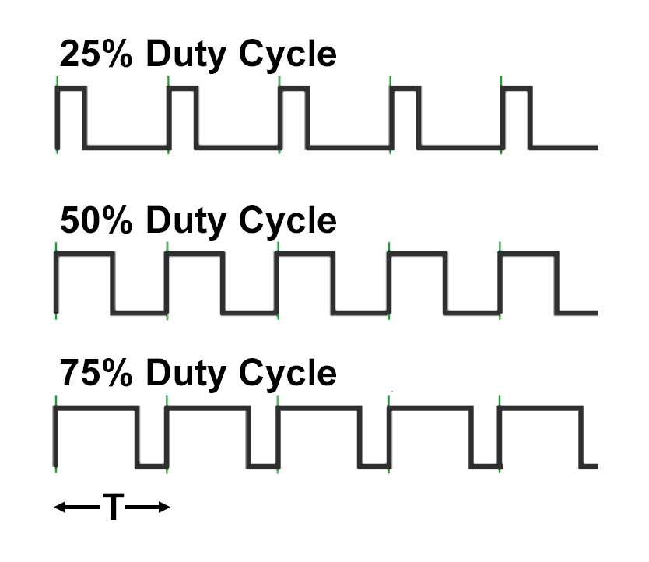
Stirring Control – driving the motor
Used Pulse Width Modulation (PWM) to increase or decrease motor speed
Calculated RPM value is compared against required RPM
Specification states accuracy required to be within +- 20 RPM
If RPM greater than upper threshold then PWM value is lowered
If RPM lower than lower threshold then PWM value is increased
PWM has a range of 0-255 and an increment of 2 was decided through testing time taken to reach target RPM

Slide 6
Stirring Control – data and test results
Range of acceptable values at 700 RPM was 680-720
Range of acceptable values at 1000 RPM was 980-1020
RPM reaches required value and may oscillate within accepted range (blue)
RPM also occasionally drops below required value only to then self correct itself (red)
RPM consistently increases at the start regardless of required RPM (green)
Revolutions Per Minute (RPM) Required RPM set to 700
870
930
840
750
690
720
690
690
720
660
720
Revolutions Per Minute (RPM) Required RPM set to 1000
870
1140
1080
990
990
990
990
1020
960
990
990

Slide 7
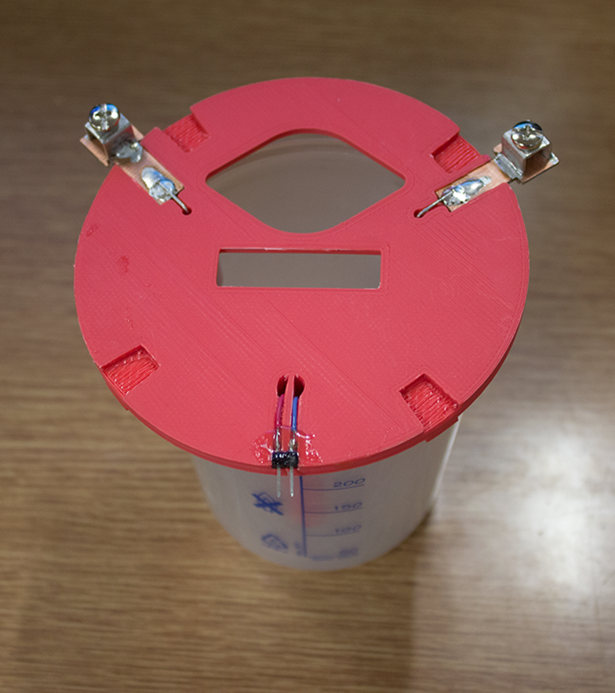
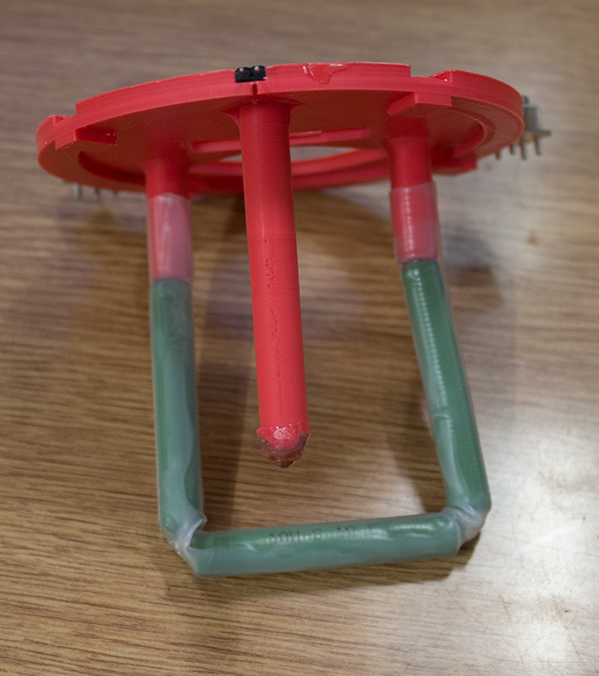
Temperature Control Subsystem
Thermistor
Heater

Slide 8
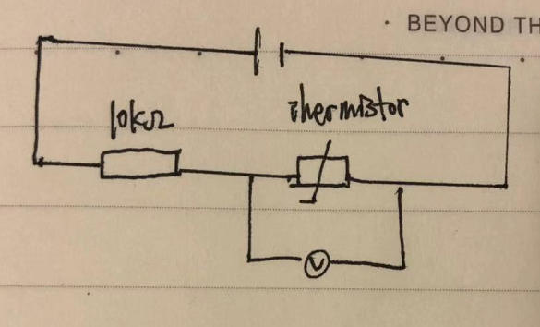
Temperature Control – Thermistor
5V Power supply
A 10kΩ NTC Thermistor (ND06P00103K)
A 10KΩ resistor
T=B/(ln(R/R0)+B/T0)

Slide 9
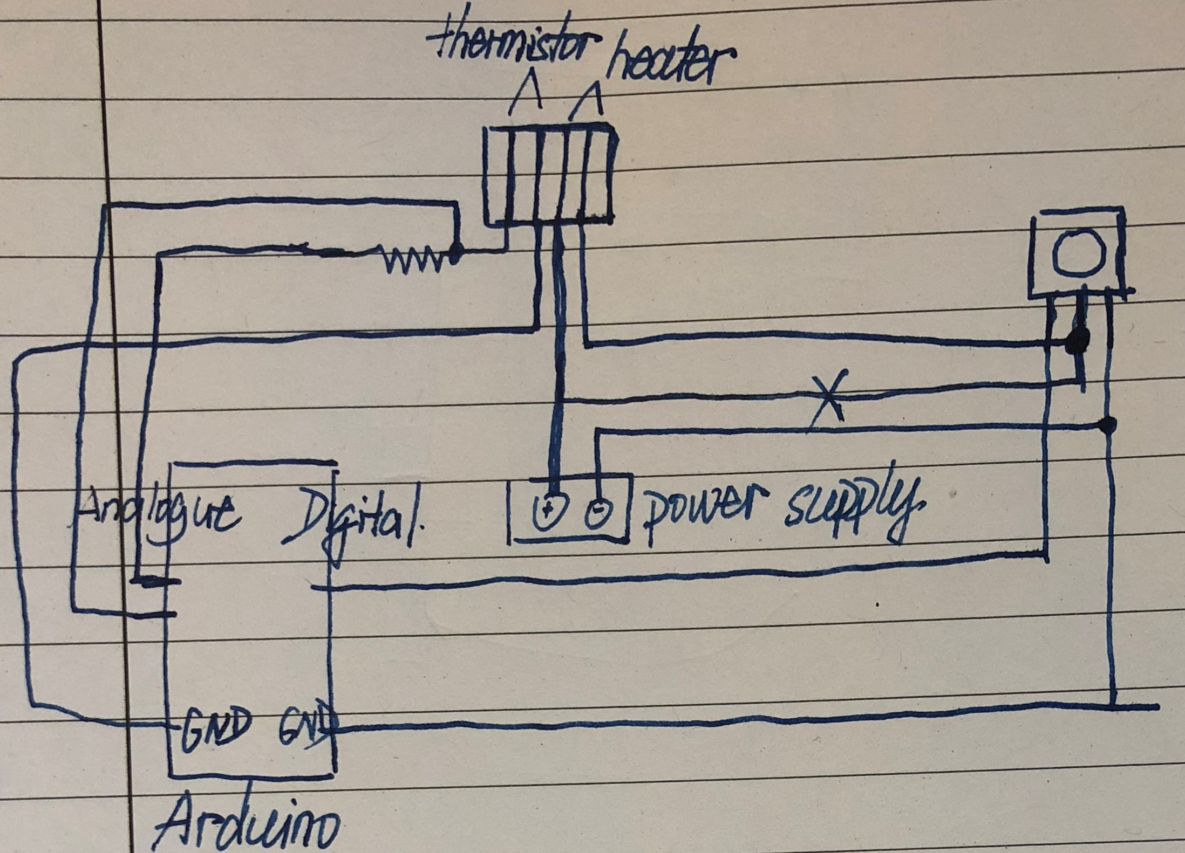
Temperature Control – Heating
12V4A power supply, 3Ω 30W heater and n-type MOSFET
PWM used to control the power through the heater
MOSFET Gate/Drain/Source
Diode used for protection

Slide 10
Temperature Control – data and test results
measured value | actual value | the difference | the ammeter reading in mA
36.70 | 37.0 | 0.30 | 1.89
36.70 | 36.9 | 0.20 | 1.90
36.79 | 37.0 | 0.21 | 1.90
36.89 | 37.2 | 0.31 | 1.90
36.98 | 37.2 | 0.22 | 1.90
37.18 | 37.2 | 0.02 | 1.91
37.66 | 37.2 | -0.46 | 0.00
37.86 | 37.5 | -0.36 | 0.00
37.86 | 38.0 | 0.14 | 0.00
Thus we decided to stop 0.4C before the set value.
set 38, stop at set value-0.5C, PWM 160
This time we slightly changed the code for thermistor so that there is no need for the offset, and also we connected the right pin to the digital ground on the Arduino. This is essential for the PWM as the signal needs to complete the whole circuit in order to have it function properly.

Slide 11
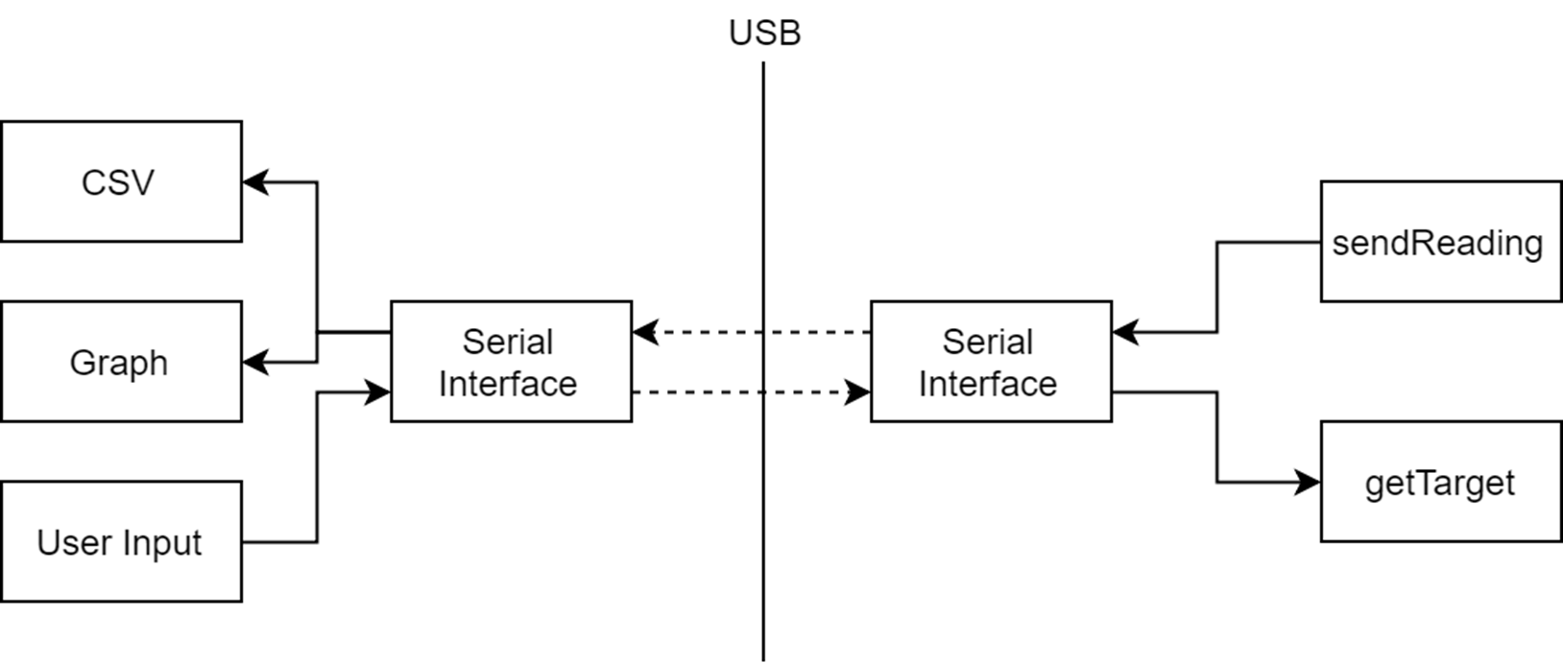
User Interface

Slide 12
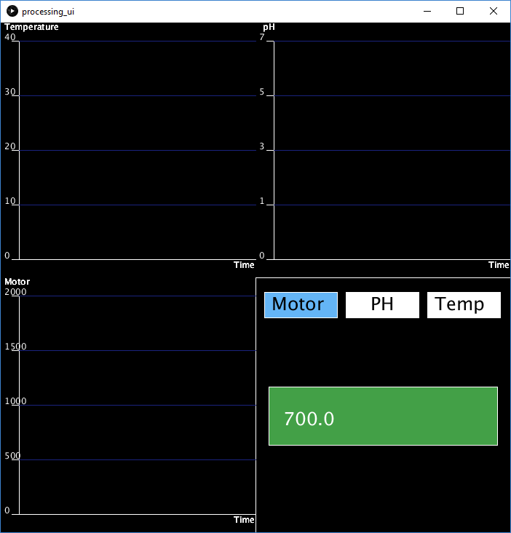
Serial Messages
Text based encoding
SENSOR <millis> <value>
SET <constant> <value>
DEBUG <message>

Slide 13
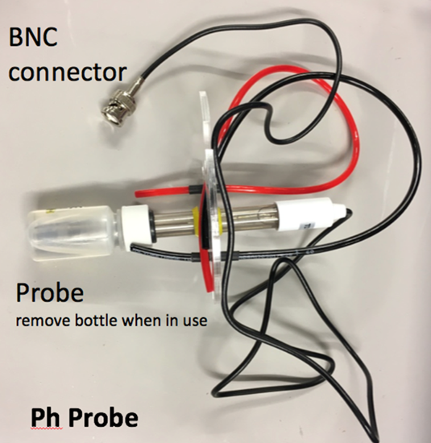
pH system- pH Probe circuit

Slide 14
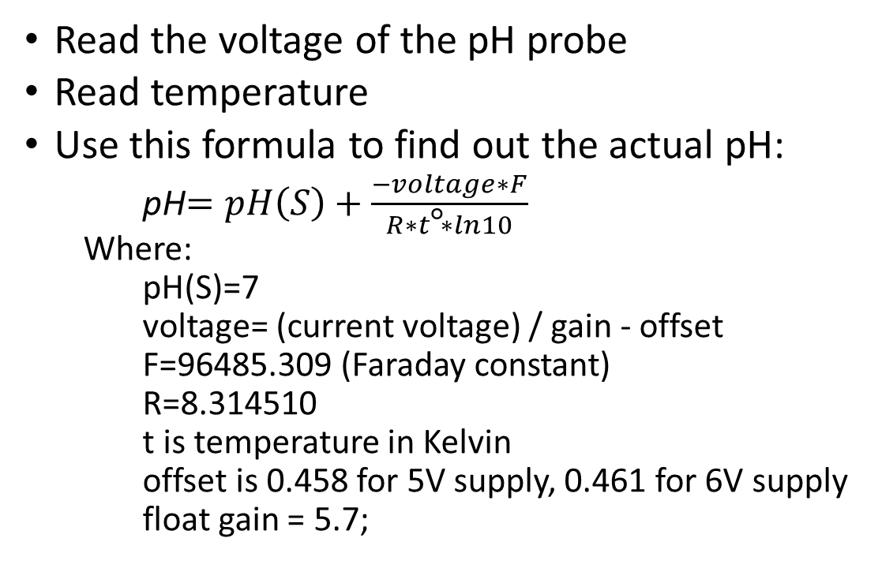
pH system- Finding out the pH value
Read the voltage of the pH probe
Read temperature
Use this formula to find out the actual pH:
pH$=pH\left(S\right)+\frac{−voltage∗F}{R∗t\text{°}∗ln10}$
Where:
pH(S)=7
voltage= (current voltage) / gain - offset
F=96485.309 (Faraday constant)
R=8.314510
t is temperature in Kelvin
offset is 0.458 for 5V supply, 0.461 for 6V supply
float gain = 5.7;

Slide 15
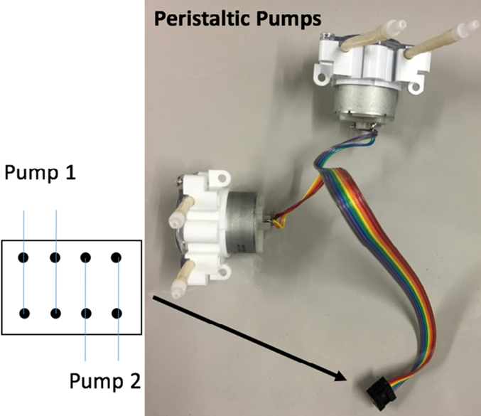
pH system – Peristaltic pumps circuit

Slide 16
pH system – Turning on the pumps
Our ideal pH is between 4.75 and 5.25
If our current pH is less than 4.75 we need to open the pump connected to the basic solution
If our current pH is more than 5.25 we need to open the pump connected to the acidic solution

Slide 17
pH system – Test and results
Measured pH | Actual pH | Difference
8.41 | 8.43 | 0.02
9.77 | 9.77 | 0.00
4.50 | 4.61 | -0.11
3.20 | 3.27 | 0.07
5.15 | 5.10 | -0.05
These tests were taken at the temperature of 25 degrees Celsius

